Slide 1
FRUIT QUALITY DETECTION USING DEEP LEARNING FOR ROTTEN AND FRESH FRUITS CLASSIFICATION
Presented by
Prabhakaran M
II MCA
731223622009
Guided by
Dr.N.Sathyabalaji.,M.E.,M.I.S.T.E.,Ph.D.
(Associate Professor)

Slide 2
ABSTRACT
This project introduces a deep learning-based web application designed to classify fruit images into six categories: fresh apple, fresh banana, fresh orange, rotten apple, rotten banana, and rotten orange.
The classification system is powered by the EfficientNetB1 model, a lightweight yet powerful convolutional neural network known for its optimized performance and accuracy.
The model has been trained to detect subtle visual cues in fruit images that distinguish freshness from decay, making it suitable for quality control tasks in agricultural and retail environments.
To improve prediction accuracy and generalization, especially when handling rotated or slightly varied input images, the system incorporates Test-Time Augmentation (TTA).

Slide 3
EXISTING SYSTEM
The freshness of fruits is considered to be one of the essential characteristics for consumers in determining their quality, flavor and nutritional value.
The primary need for identifying rotten fruits is to ensure that only fresh and high-quality fruits are sold to consumers.
The impact of rotten fruits can foster harmful bacteria, molds and other microorganisms that can cause food poisoning and other illnesses to the consumers.
Hence, this research work mainly focuses on the Convolutional Neural Network’s (CNN) deep learning model, which helps in the classification of rotten fruits.
In comparison to other pretrained models, the visual geometry group16 (VGG16) obtained a higher accuracy score of 95%.

Slide 4
DRAWBACKS
The accuracy of the CNN model and other machine learning models is highly dependent on the quality and variety of the training data.
If the dataset doesn't include sufficient representations of all fruit types and spoilage stages, the model may struggle with generalization, leading to misclassification.
The current system primarily focuses on fruits like apples, bananas, oranges, papayas, and guavas.
This narrow focus may limit the system's applicability in scenarios where a broader range of fruit types is involved, requiring further adaptation for diverse fruit categories.
Deep learning models like CNN, particularly pre-trained models like VGG16, require significant computational resources for training and real-time inference.

Slide 5
PROPOSED SYSTEM
The proposed system is a deep learning-based image classification model designed to identify the freshness status of fruits using EfficientNetB1 architecture.
The system accepts images of apples, bananas, and oranges, and classifies them into one of six categories: fresh apple, fresh banana, fresh orange, rotten apple, rotten banana, and rotten orange.
To ensure robustness against variations in image orientation, lighting, and background, the system incorporates Test-Time Augmentation (TTA).
This technique enhances the model’s ability to generalize across diverse and potentially noisy input data, which is common in applications.

Slide 6
ADVANTAGES
The system provides accurate and reliable predictions by leveraging a deep learning model, ensuring that fruits are classified correctly based on their visual features.
By incorporating Test-Time Augmentation, the model becomes more robust, improving its performance under various conditions, such as variations in lighting, orientation, and image quality.
The user-friendly interface allows anyone, even with minimal technical knowledge, to easily upload images and receive instant results, making it accessible for a wide range of users.
The EfficientNetB1 architecture used in the model optimizes computational efficiency, delivering high accuracy while minimizing resource consumption, which is ideal for both cloud-based and edge-device applications.

Slide 7
SYSTEM FLOW DIAGRAM
IMAGE UPLOAD
Pre-Processing
CLASSIFICATION
USER INTERFACE
PREDICTION AND VISUALIZATION
TEST-TIME AUGMENTATION (TTA)
Output

Slide 8
SYSTEM SPECIFICATION
HARDWARE REQUIREMENTS
CPU type : Intel core i3 processor
Clock speed : 3.0 GHz
RAM size : 8 GB
Hard disk capacity : 40 GB
Keyboard type : Internet Keyboard
CD -drive type : 52xmax
SOFTWARE REQUIREMENTS
Operating System : Windows 10
Front End : python

Slide 9
MODULES
IMAGE UPLOAD
PREPROCESSING
CLASSIFICATION
TEST-TIME AUGMENTATION
PREDICTION AND VISUALIZATION
USER INTERFACE

Slide 10
IMAGE UPLOAD
This module serves as the entry point for users to interact with the system.
It enables users to upload fruit images in supported formats such as JPG, JPEG, or PNG.
The uploaded image is temporarily stored and displayed on the interface for confirmation.
This module ensures that the system receives valid and usable image inputs while maintaining a user-friendly experience.
It acts as a crucial bridge between the user and the backend processing pipeline.

Slide 11
PREPROCESSING
Once an image is uploaded, it is passed to the preprocessing module, which standardizes the image before feeding it into the classification model.
This includes converting the image to RGB, resizing it to a fixed dimension (240x240 pixels), and normalizing pixel values to a scale of 0 to 1.
These steps are essential for maintaining consistency across various input images and ensuring compatibility with the trained EfficientNetB1 model.
The preprocessing also helps reduce noise and enhances the model’s ability to make accurate predictions.

Slide 12
CLASSIFICATION
At the core of the system lies the classification module, which leverages a pre-trained EfficientNetB1 model.
This deep learning model has been trained to distinguish between six classes of fruits—fresh and rotten variants of apples, bananas, and oranges.
The module receives the preprocessed image and generates predictions based on learned features.
It identifies subtle differences in texture, color, and shape to accurately classify the image into its respective category.

Slide 13
TEST-TIME AUGMENTATION
To improve the robustness and accuracy of predictions, the system incorporates Test-Time Augmentation
This module applies a series of random rotations to the input image and performs multiple inference passes using the augmented versions.
The results of these passes are then averaged to produce a final prediction.
TTA helps the model handle variations such as different angles or slight distortions in user-uploaded images, thus enhancing its reliability.

Slide 14
PREDICTION AND VISUALIZATION
After the classification is complete, the prediction and visualization module displays the results in an informative manner.
It shows the predicted class label along with a confidence percentage, helping users understand the certainty of the model’s output.
Additionally, it presents the top three class predictions with progress bars, offering deeper insight into the model’s reasoning.
This enhances transparency and user trust in the system’s performance.

Slide 15
USER INTERFACE
The user interface module is built using Streamlit, offering a clean, responsive, and interactive platform for end-users.
It integrates all other modules into a seamless workflow, guiding users from image upload to result interpretation.
The interface includes visual feedback, loading indicators during processing, and aesthetic design elements like emojis and headers to make the experience engaging and intuitive.
It ensures that even users with no technical background can interact with the system effortlessly.

Slide 16
CONCLUSION
In conclusion, the fruit freshness classification system effectively combines deep learning and image processing techniques to offer an automated solution for distinguishing between fresh and rotten fruits.
By utilizing the EfficientNetB1 model with Test-Time Augmentation (TTA), the system ensures high accuracy and robustness, even under varied and challenging conditions.
The user-friendly interface built with Stream lit allows for easy interaction, making it accessible to users from different backgrounds.
Additionally, the model’s efficiency in terms of computational resources enables its deployment on a wide range of devices, from high-performance servers to more limited edge devices.

Slide 17
FUTURE WORK
For future work, the fruit freshness classification system can be further enhanced by expanding the dataset to include a wider variety of fruits and more diverse environmental conditions, such as different lighting, backgrounds, and angles.
This would help improve the model's generalization and robustness. Additionally, integrating other advanced deep learning techniques,
such as transfer learning or reinforcement learning, could further boost performance, especially in handling edge cases like partially damaged fruits.
Another promising avenue would be the development of a mobile application that allows users to upload images directly from their smartphones for on-the-go fruit inspection.

Slide 18
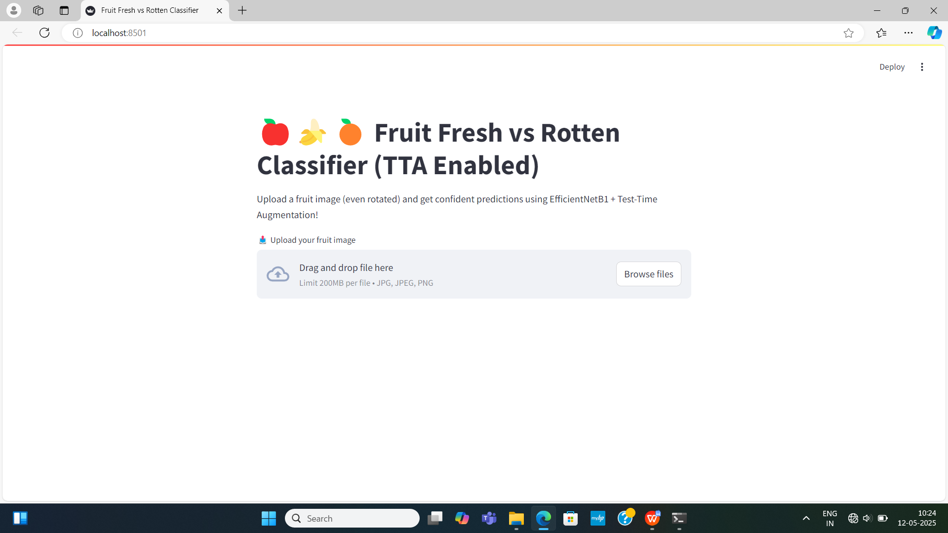
SCREEN SHOT

Slide 19
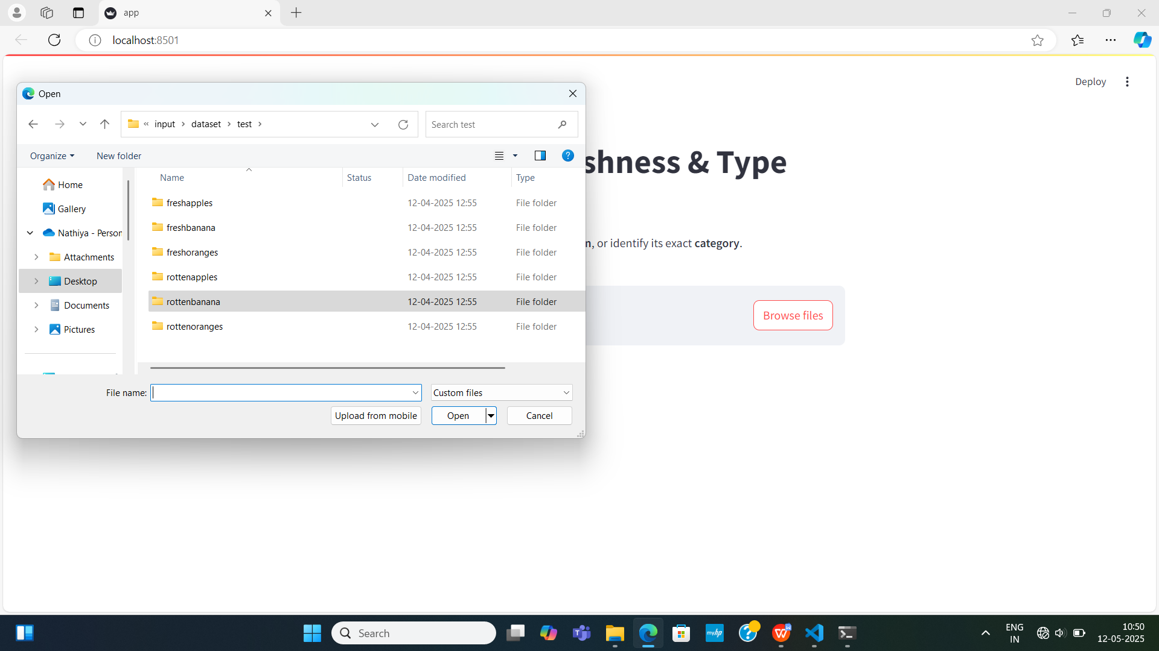

Slide 20
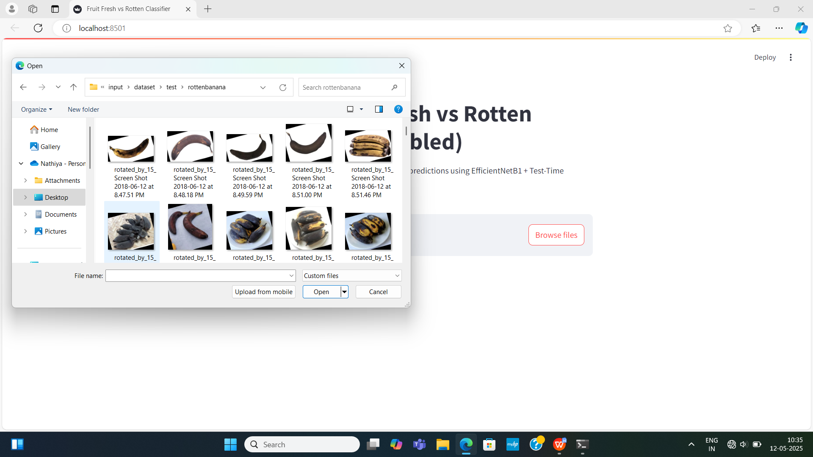

Slide 21
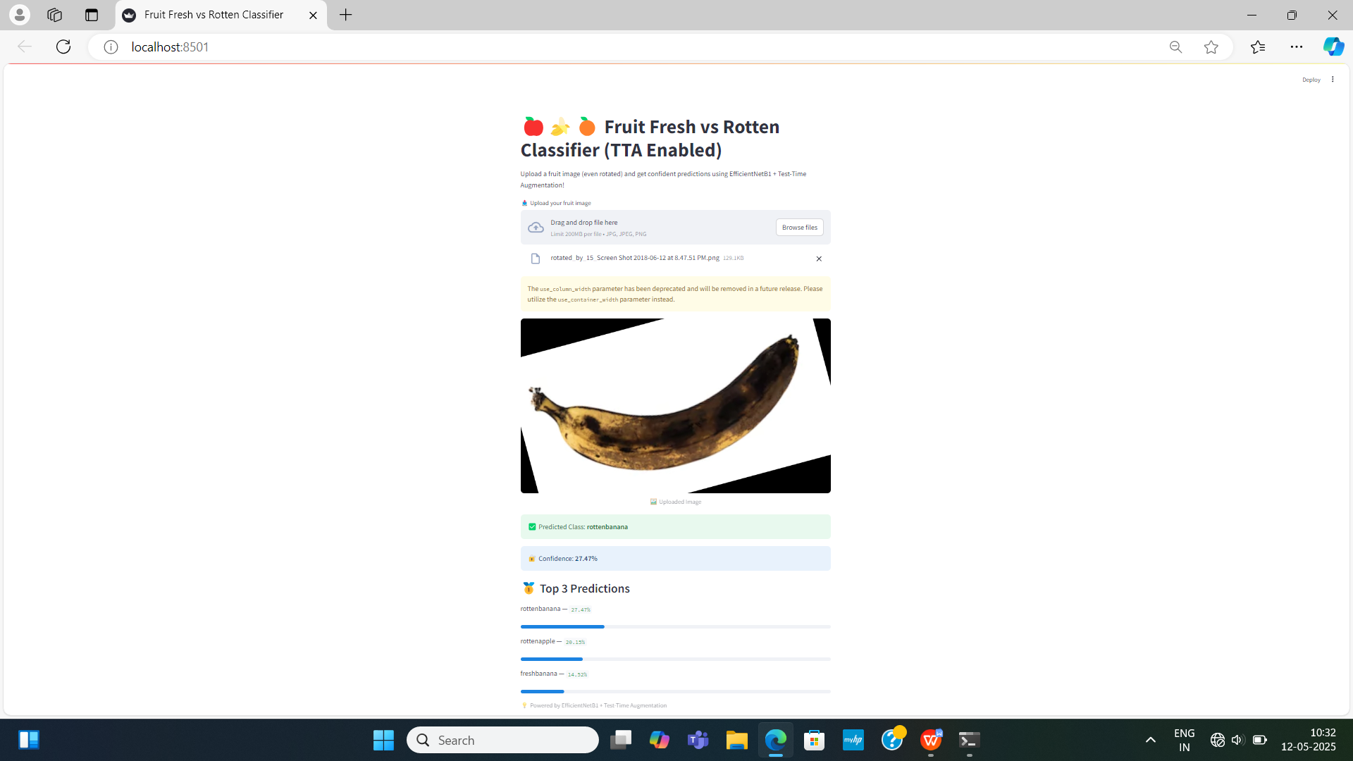

Slide 22
REFERENCES
M. Mukhiddinov, A. Muminov and J. Cho, “Improved classification approach for fruits and vegetables freshness based on deep learning,” Sensors, vol. 22, no. 21, pp. 1–20, 2022.
N. Saranya, K. Srinivasan and S. K. P. Kumar, “Banana ripeness stage identification: A deep learning approach,” Journal of Ambient Intelligence and Humanized Computing, vol. 13, no. 8, pp. 4033–4039, 2022.
S. S. R. Mamidi, C. A. Munaganuri, T. Gollapall and A. T. V. S. Aditya, “Implementation of machine learning algorithms to identify freshness of fruits,” in Proc. of Third Int. Conf. on Intelligent Computing Instrumentation and Control Technologies (ICICICT), Kannur, India, pp. 1395–1399, 2022.
N. Aherwadi and U. Mittal, “Fruit quality identification using image processing, machine learning, and deep learning: A review,” Advances and Applications in Mathematical Sciences, vol. 21, no. 5, pp. 2645– 2660, 2022.

Slide 23
THANK YOU!!

